Slide 1

Global response patterns of plant functional traits to N and P addition are driven by additive interactions
Evan A. Perkowski

Slide 2
Nutrient availability plays an important role in shaping plant ecophysiological trait variation
Soil nutrients
Leaf nutrients

Slide 3
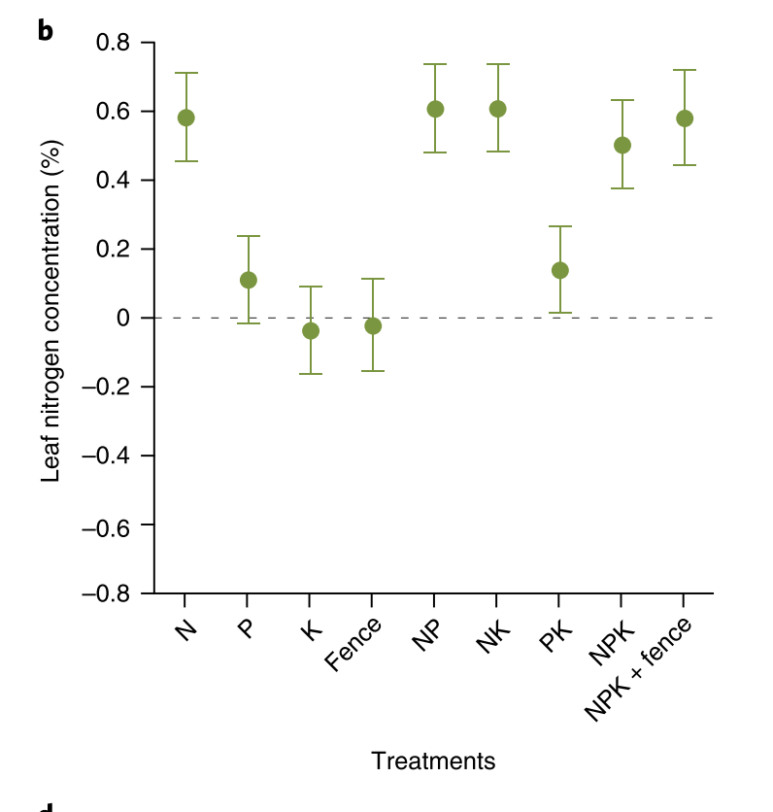
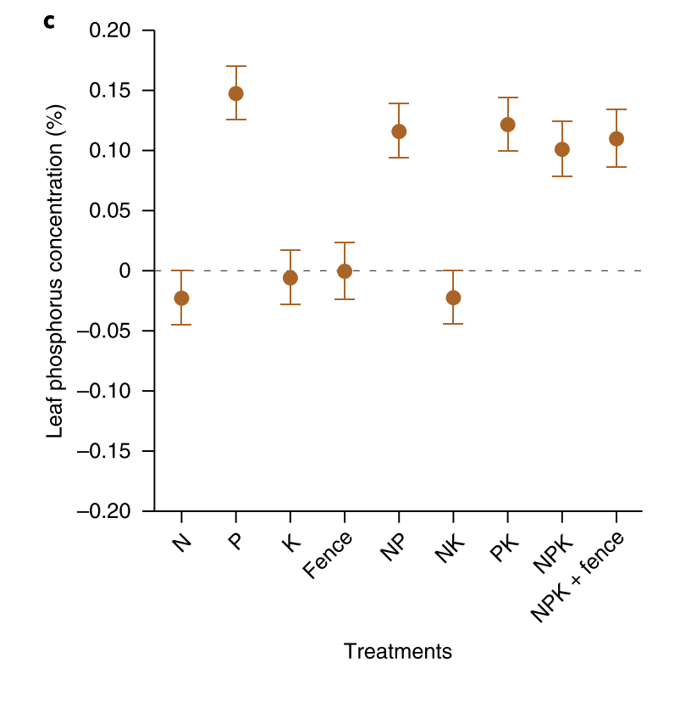
Nutrient availability plays an important role in shaping plant ecophysiological trait variation
Soil nutrients
Leaf nutrients
Firn et al. (2019) Nature Ecology & Evolution

Slide 4
Nutrient availability plays an important role in shaping plant ecophysiological trait variation
Soil nutrients
Leaf nutrients
Photosynthesis
Firn et al. (2019) Nature Ecology & Evolution

Slide 5
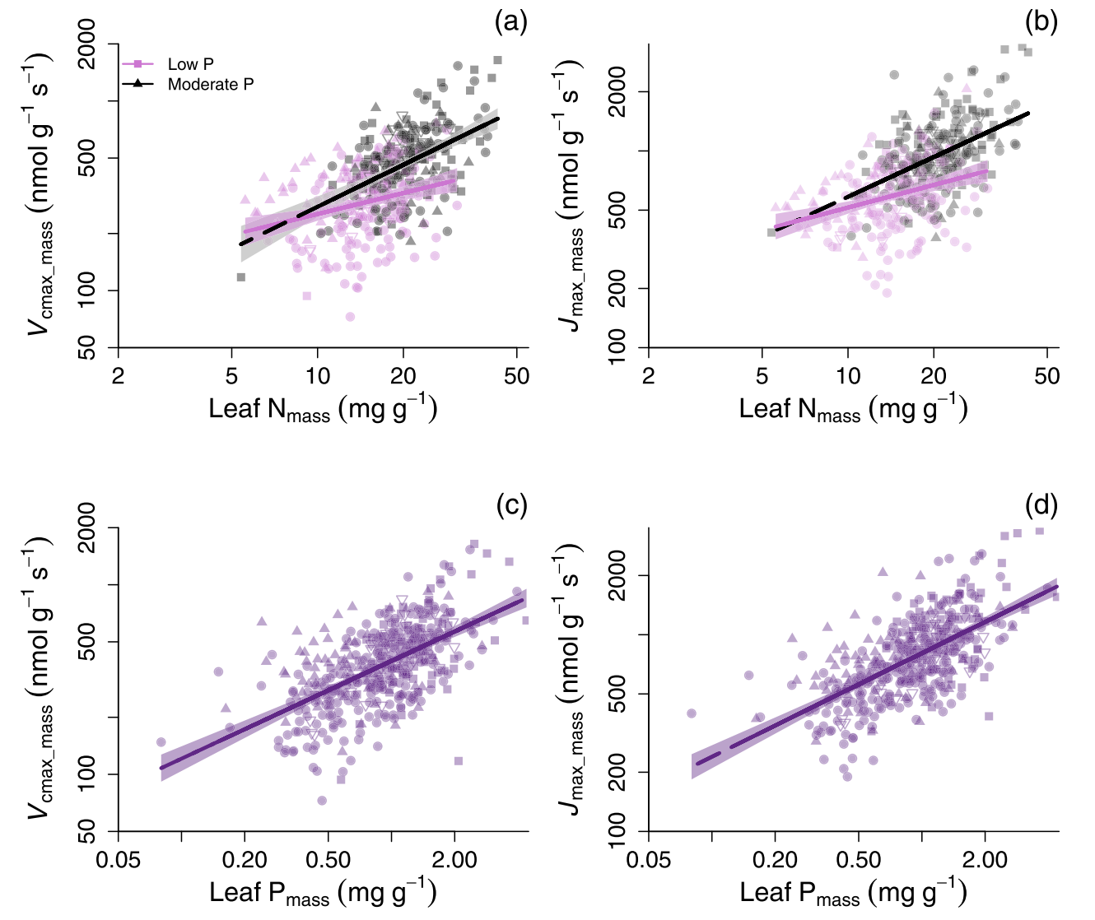
Nutrient availability plays an important role in shaping plant ecophysiological trait variation
Soil nutrients
Leaf nutrients
Photosynthesis
Firn et al. (2019) Nature Ecology & Evolution
Ellsworth et al. (2022) Nature Communications

Slide 6
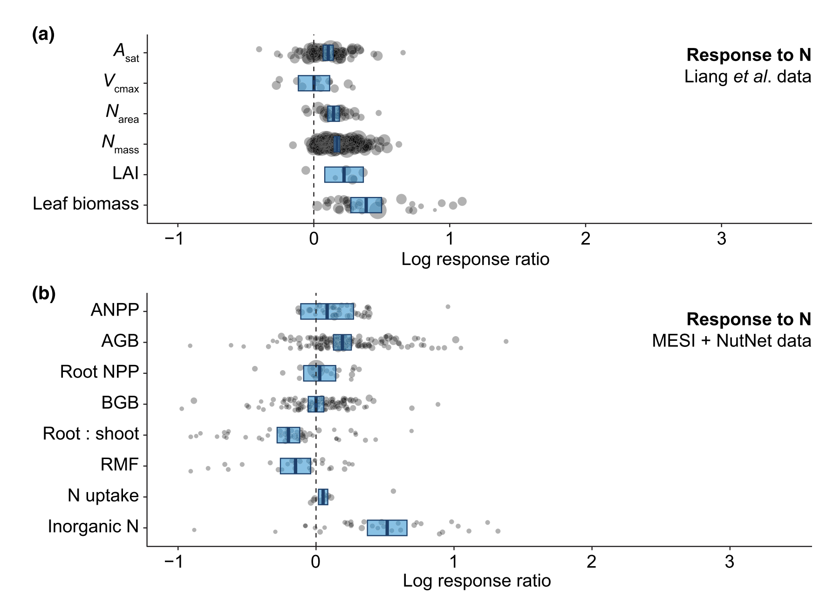
Plant responses to N addition are well-studied
Stocker et al. (2025) New Phytologist

Slide 7
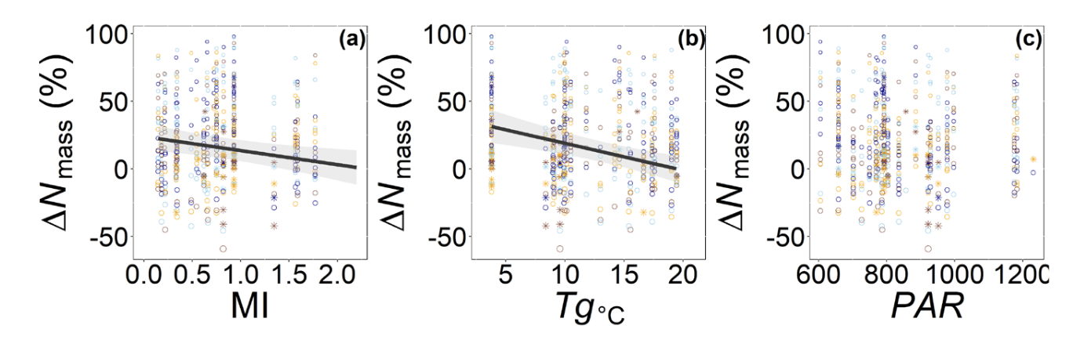
Plant responses to N addition are context dependent on climatic demand
Cheaib et al. (2025) Ecology Letters

Slide 8
But what about the role of phosphorus availability?
We currently lack data syntheses that assess the role of P availability on leaf and whole-plant traits

Slide 9
… and the interactive effect of N and P availability?
We currently lack broad data syntheses that assess the role of P availability on leaf and whole-plant ecophysiological traits

Slide 10
Main questions
How does P availability modify leaf and whole-plant traits?
How do N and P addition interact to modify leaf and whole-plant traits?
Are responses to N and P addition modified by climatic demand?

Slide 11
A meta-analytic approach

Slide 12
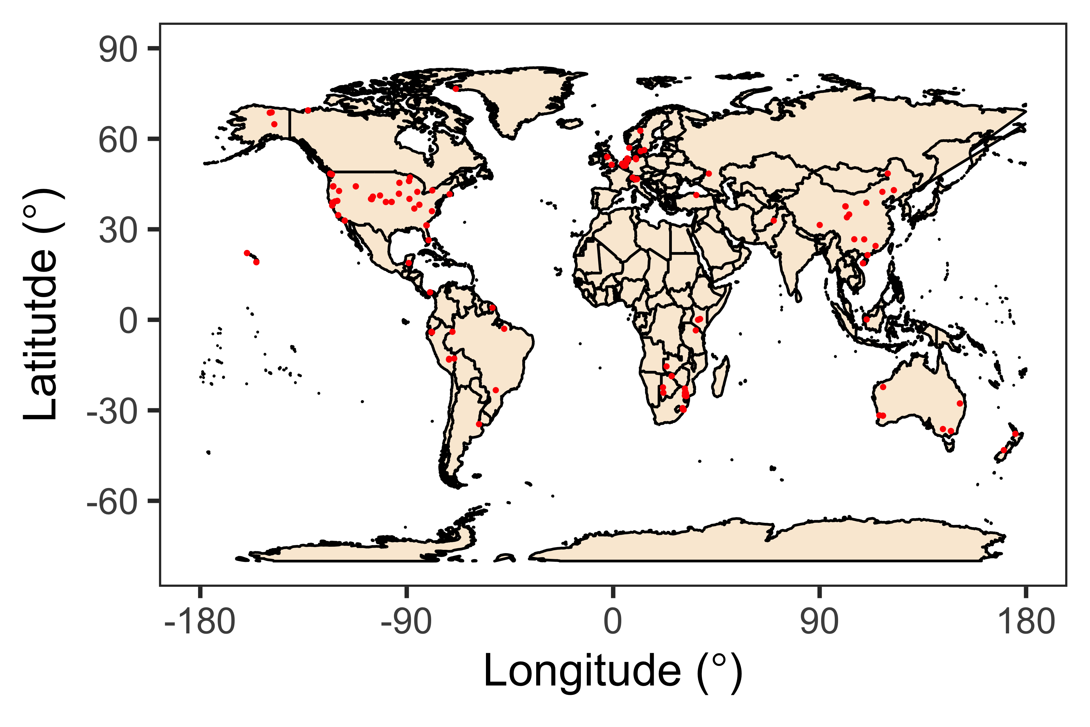
Study summary
85 studies
78 field
6 greenhouse
1 growth chamber
From field exps:
166 sites

Slide 13
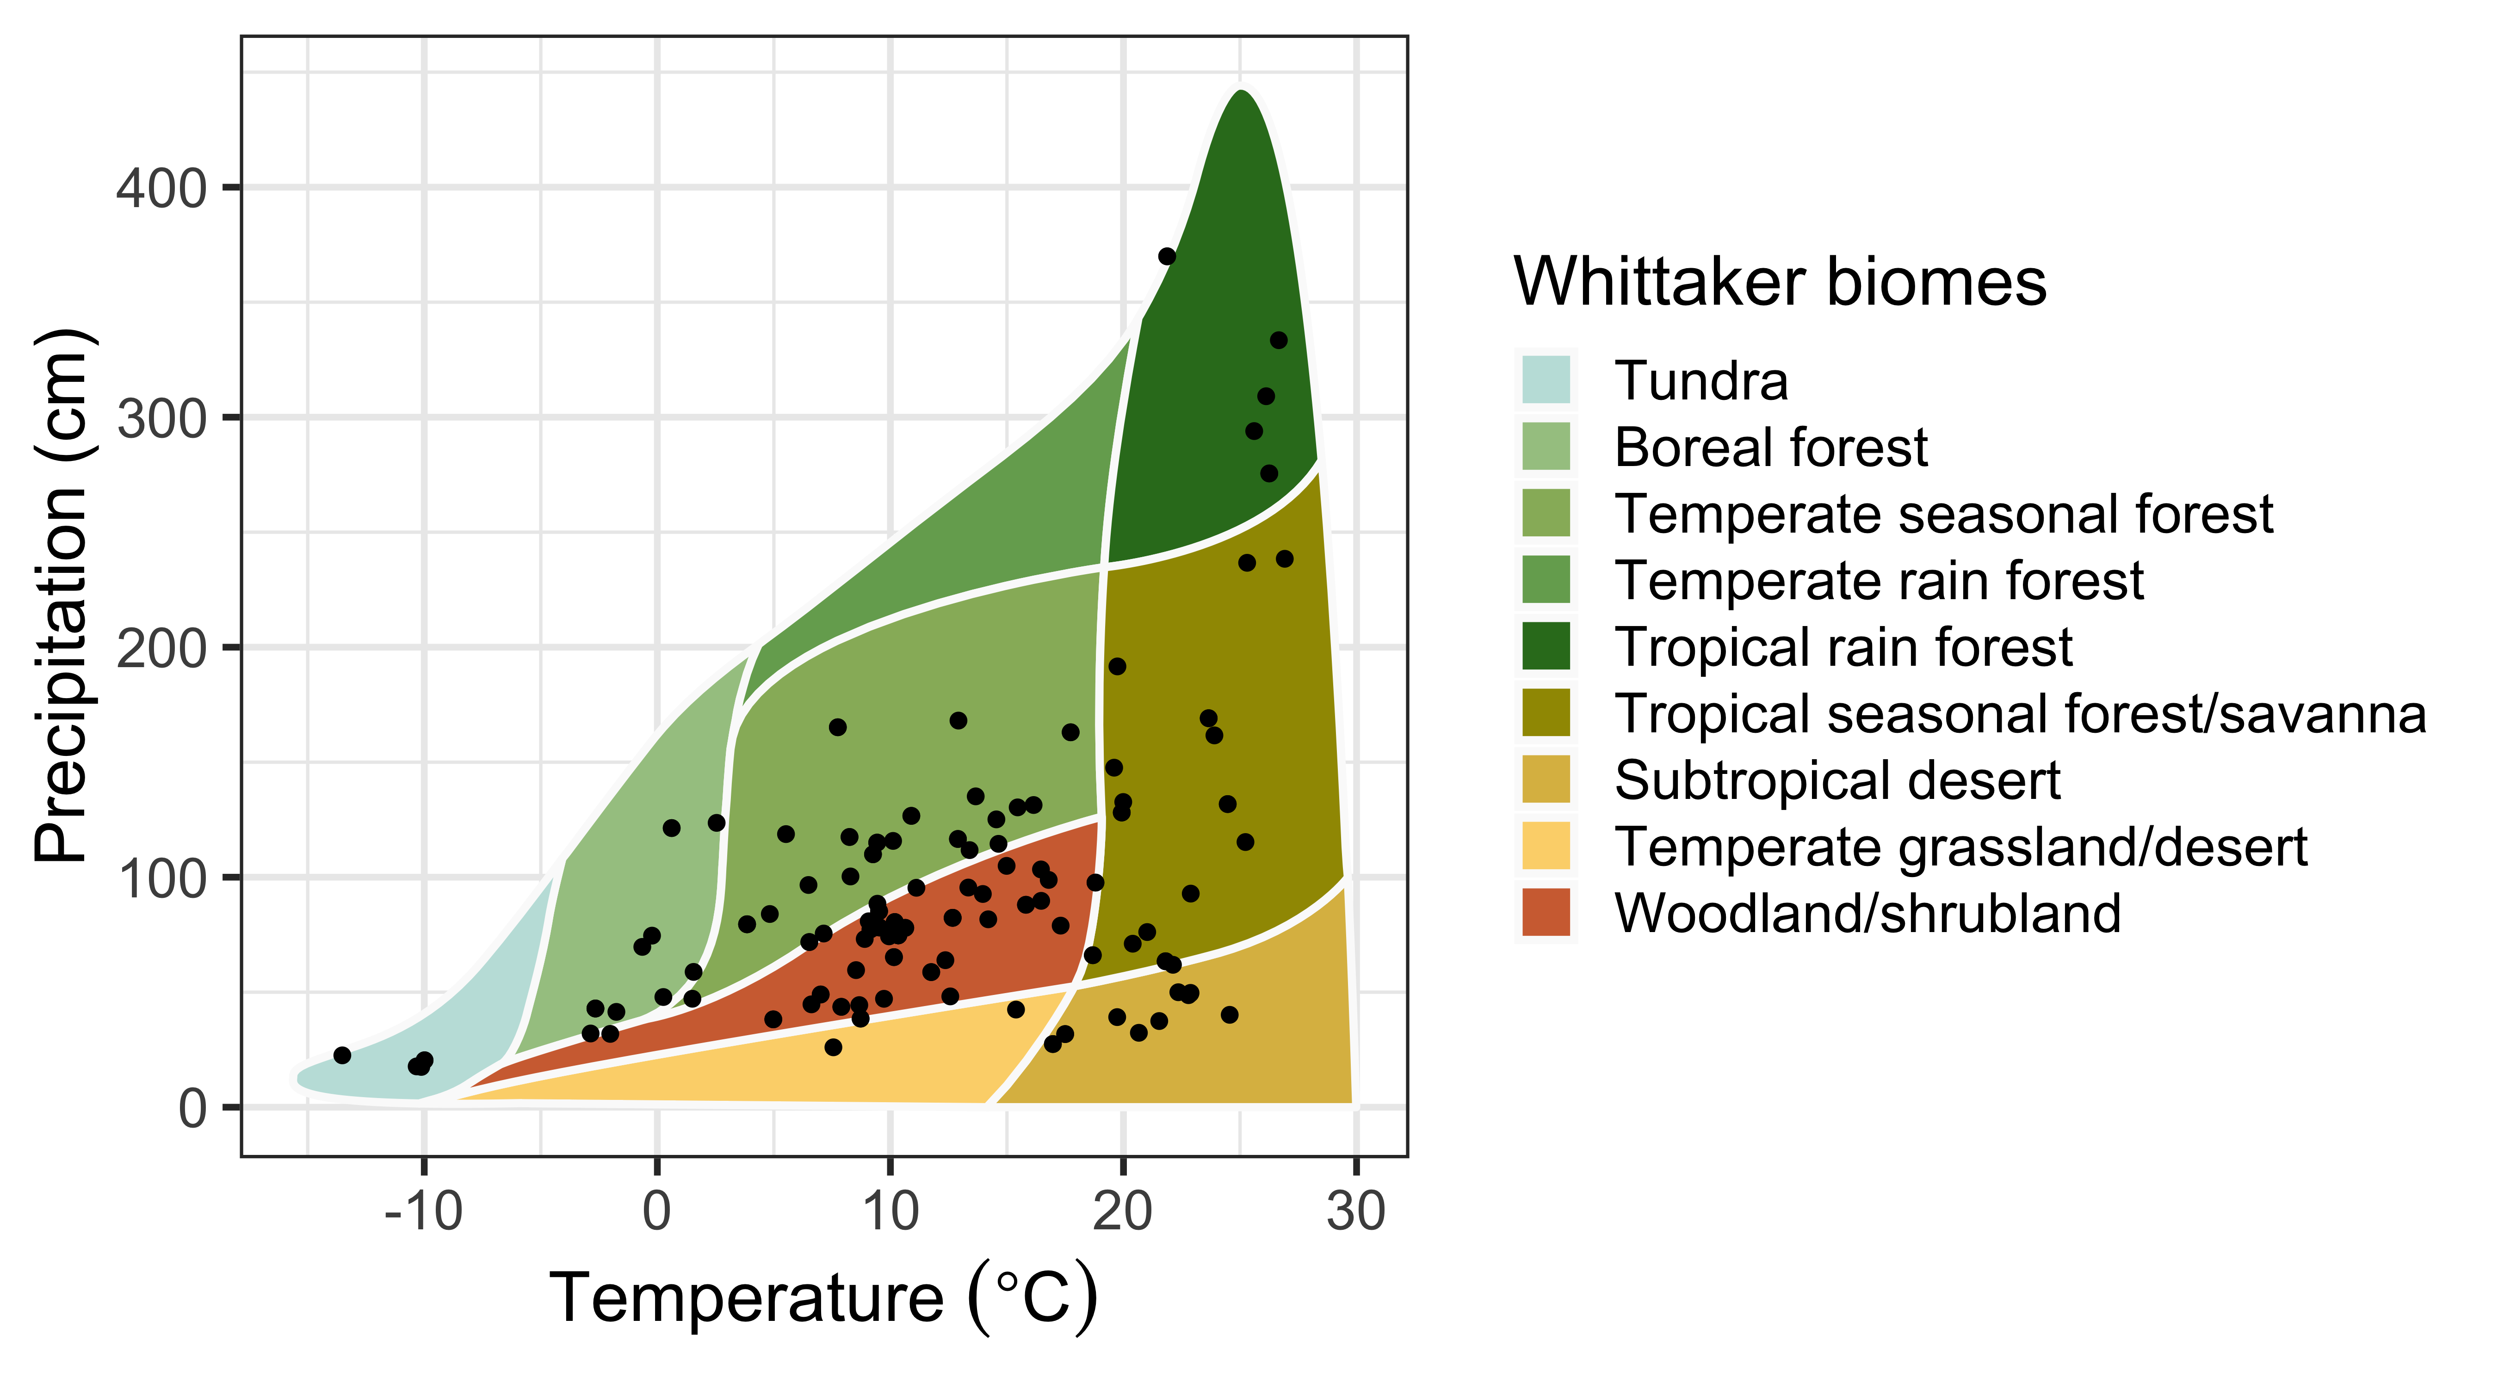
Study summary
85 studies
78 field
6 greenhouse
1 growth chamber
From field exps:
166 sites
Diverse biomes represented

Slide 14
Question 1: How does N and P addition modify leaf and whole-plant traits?

Slide 15
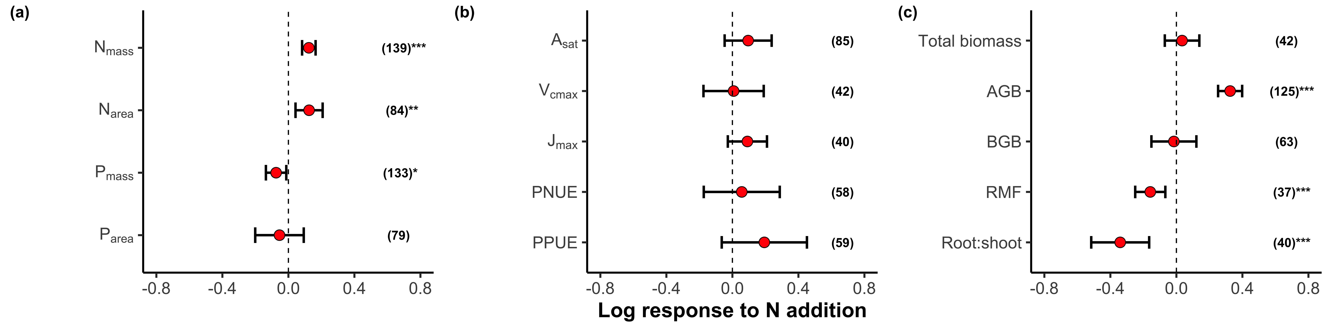
N addition increases leaf N content and aboveground biomass despite not altering leaf photosynthesis

Slide 16
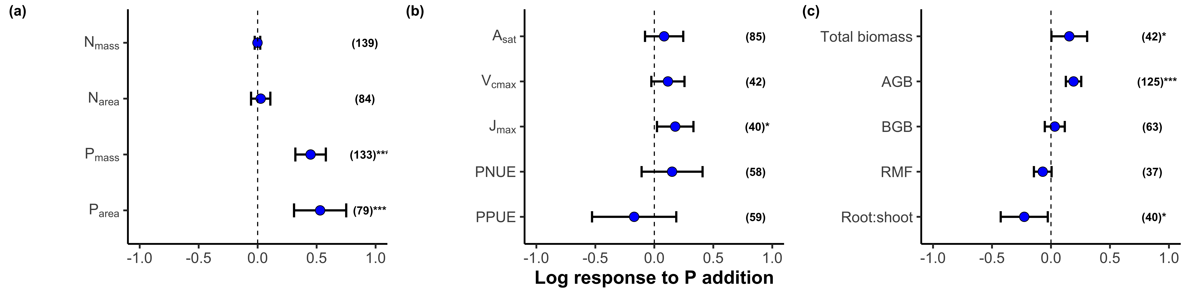
P addition increases leaf P content and biomass despite not altering leaf photosynthesis

Slide 17
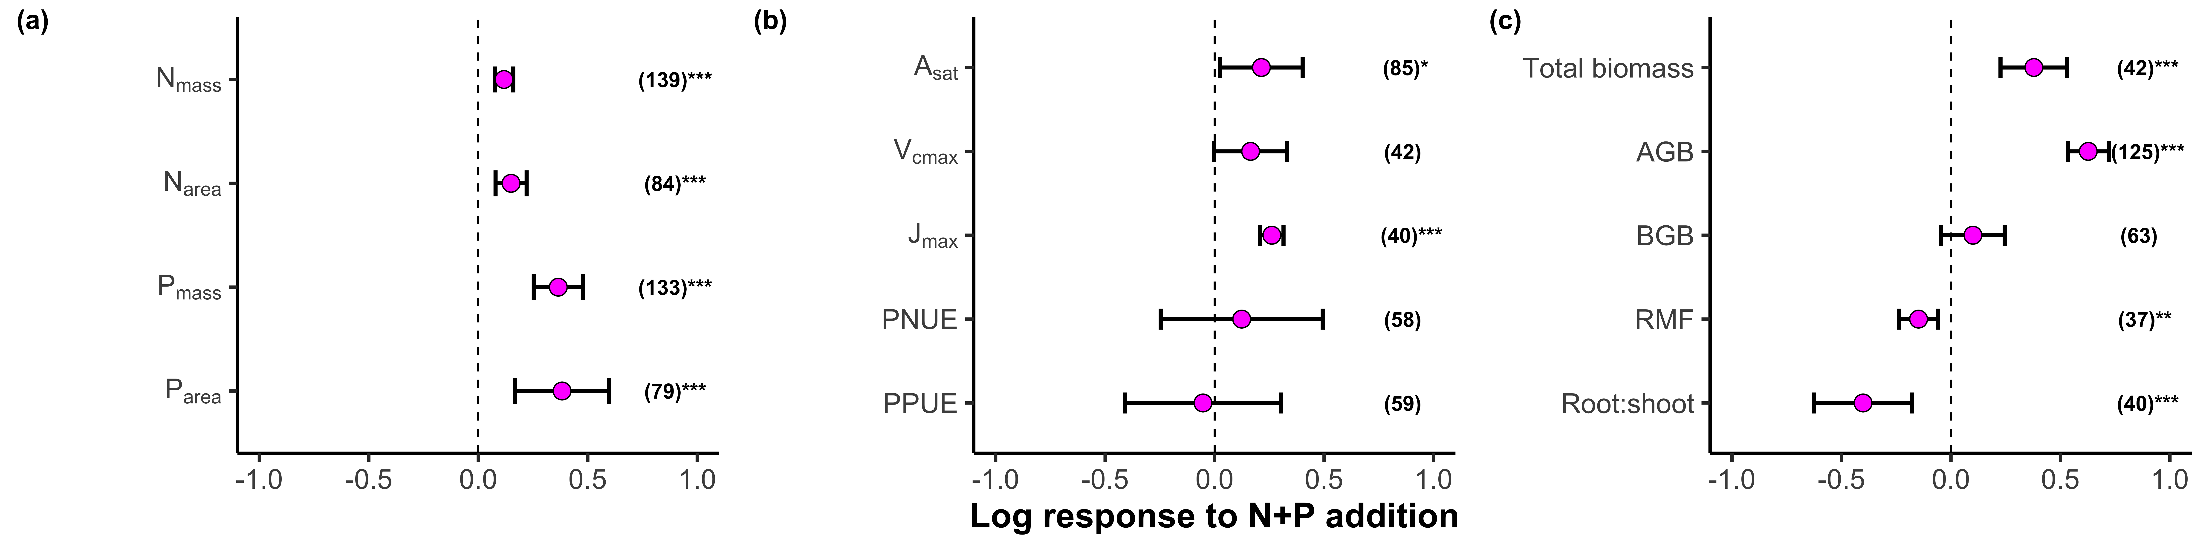
N+P addition increases leaf N and P content, leaf photosynthesis, and biomass

Slide 18
Question 2: How do N and P addition interact to modify leaf and whole-plant traits?

Slide 19
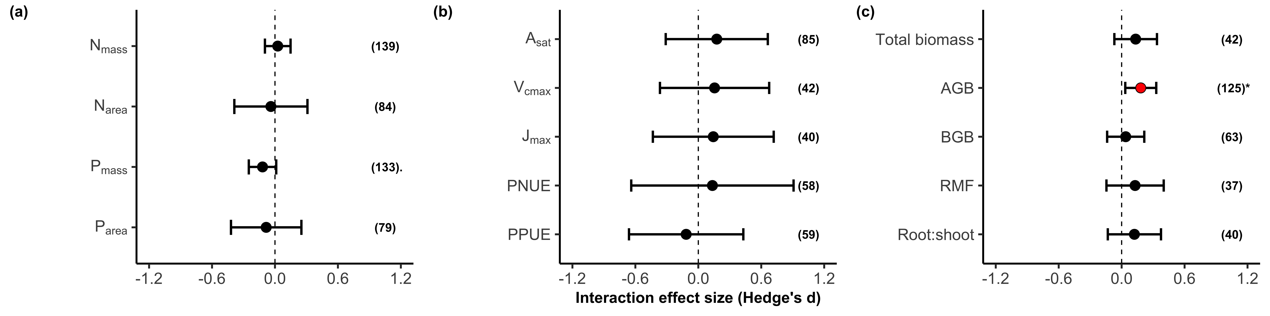
N+P addition responses are largely driven by additive interactions between N and P addition

Slide 20
N+P addition responses are largely driven by additive interactions between N and P addition
Aboveground biomass responses to N and P addition are stronger than individual effects of N and P addition on aboveground biomass

Slide 21
Question 3: Are responses to N and P addition modified by climatic demand?

Slide 22
Leaf N responses to N addition are strongest in regions with high demand (cold, wet climates)

Slide 23
Leaf P responses to P addition are also strongest in regions with high demand (cold, wet climates)

Slide 24
Main takeaways
Plant responses to N+P addition are largely driven by additive interactions
Some evidence for plant responses to N and P addition being controlled by climatic demand

Slide 25
Acknowledgements

